Slide 1
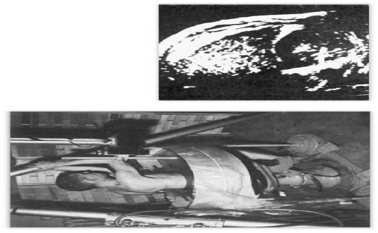
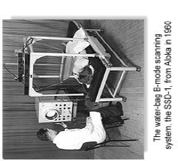
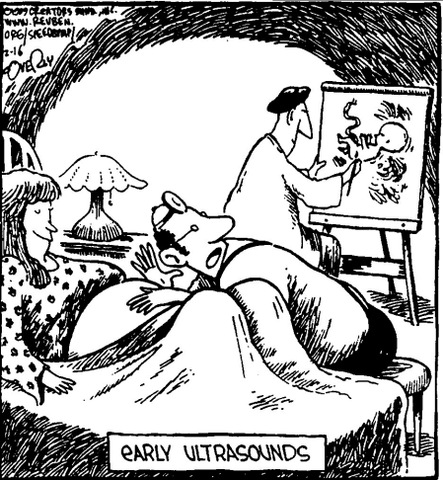
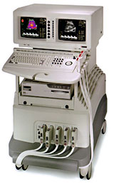
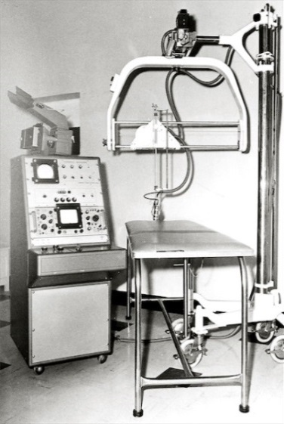
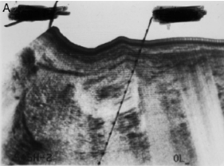
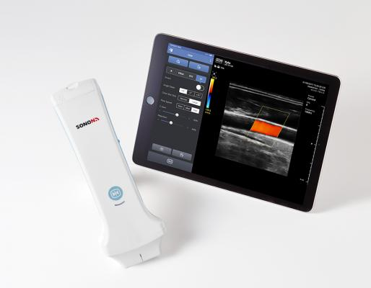
History of clinical ultrasounds
Douglass Howry 1958
From the beginning

Slide 2
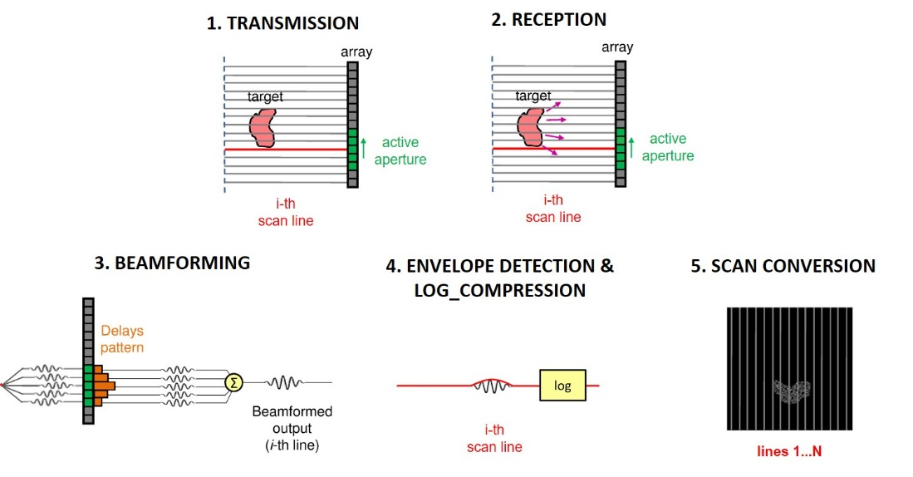
A. Ramalli, G. Matrone, P. Tortoli. Nuove tecnologie per ecografia ad ultrasuoni: da 2D a 4D. Scuola di Bioingegneria, Bressanone, 2018

Slide 3
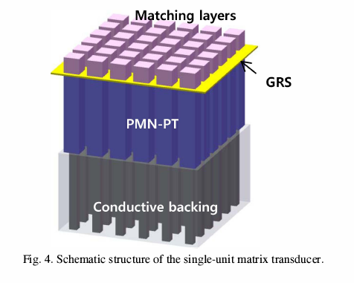
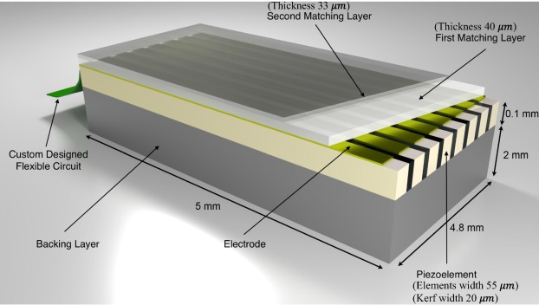
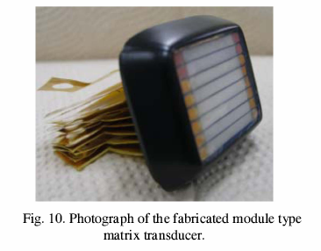
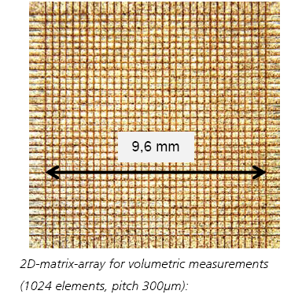
Array and Matrix piezoelectric transducers
Crystal miniaturization

Slide 4


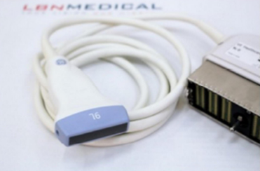
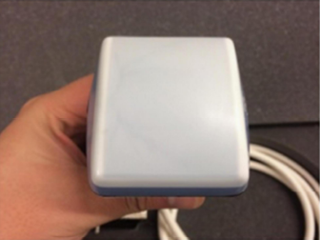


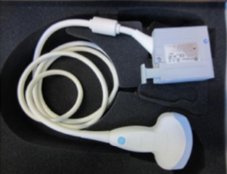
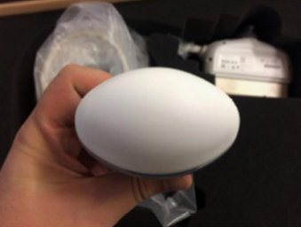
Matrix transducer
Matrix transducer

Slide 5


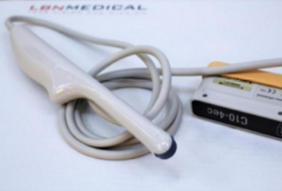
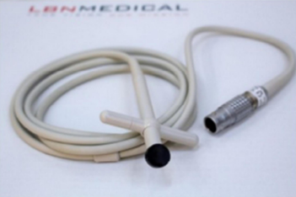


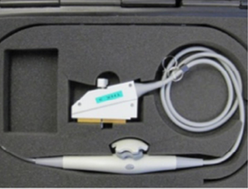
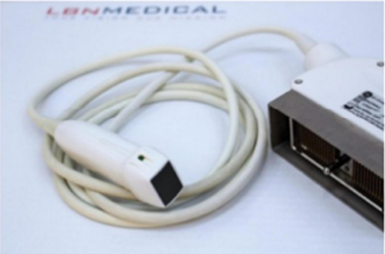

Slide 6
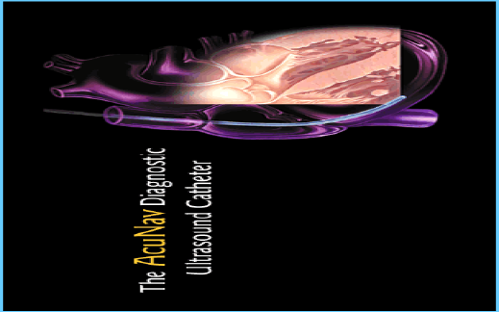
Trasduttore transesofageo

Slide 7
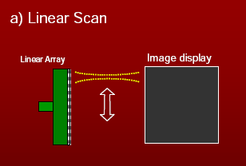
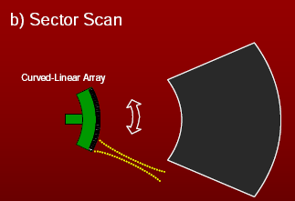
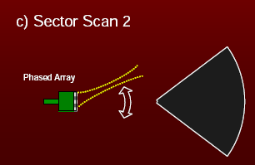
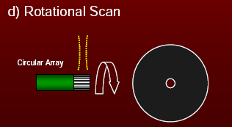
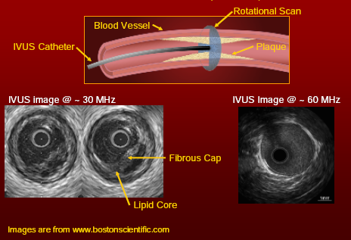
Focalization
Focalization & Steering

Slide 8
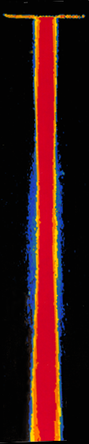
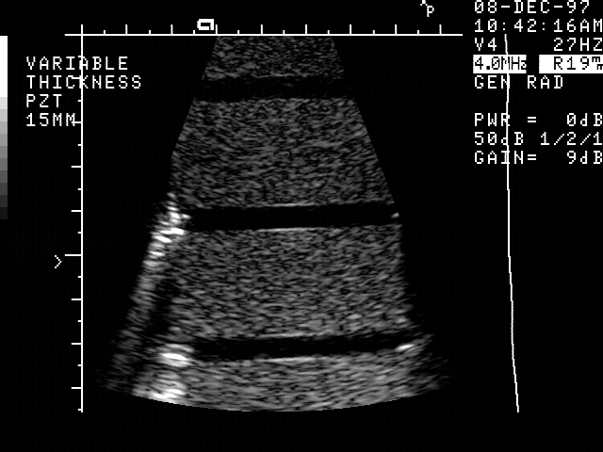
Focusing
Matrix of elements
Beam steering in three dimensions
Focalization in the image plane and outside the image plane
Matrix Transducers
Matrix
Near field
Far field
Focalization

Slide 9
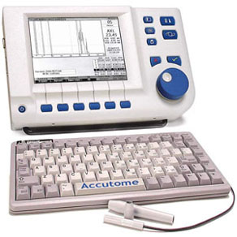
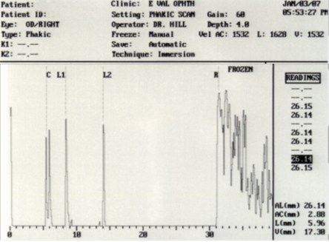
A-Scan
A-Scan (Amplitude scan)
Gives no photo image
Pulses of ultrasound sent into the body, reflected ultrasound is detected and appear as vertical spikes on a CRO screen.
The horizontal positions of the ‘spikes’ indicate the time it took for the wave to be reflected.
Commonly used to measure size of foetal head.

Slide 10
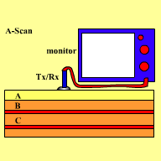
Ultrasound Simulation
Different depths or densities produce different intensities
boundaries

Slide 11
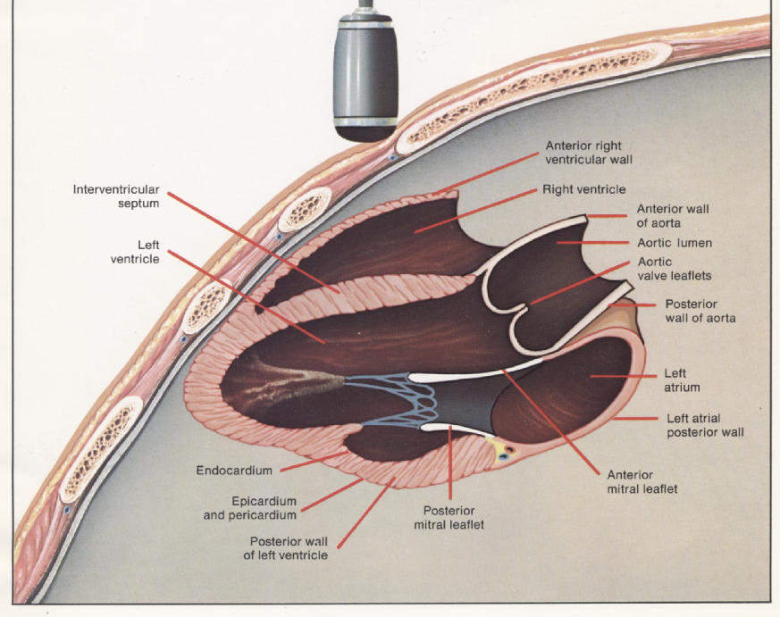

Slide 12
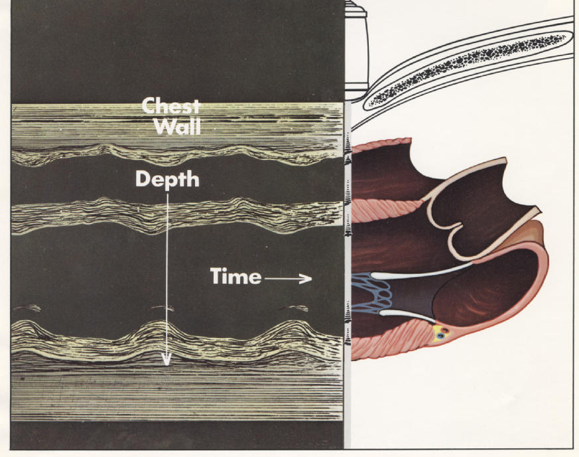

Slide 13
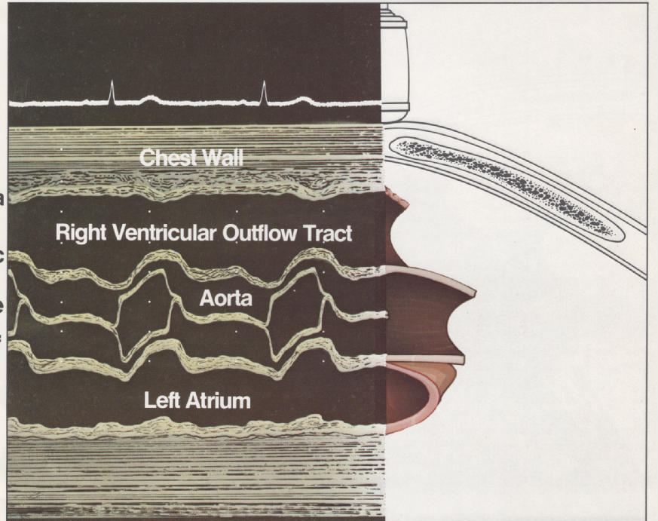

Slide 14
Ultrasound-tissue interaction
Specular vs scattering
Specular (vessels, cardiac cavity, epicardium)
Scattering (capillars, myocardial fiber,…)

Slide 15
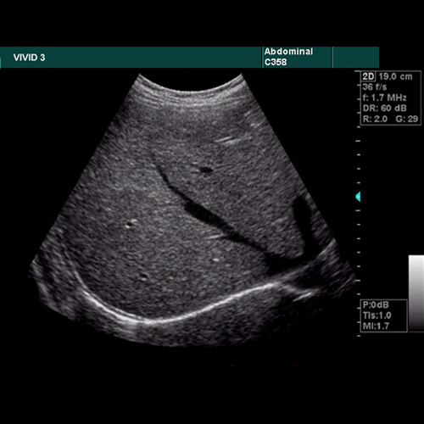
Reflected Echo’s
Strong reflections = white dots
Weaker reflections = grey dots

Slide 17
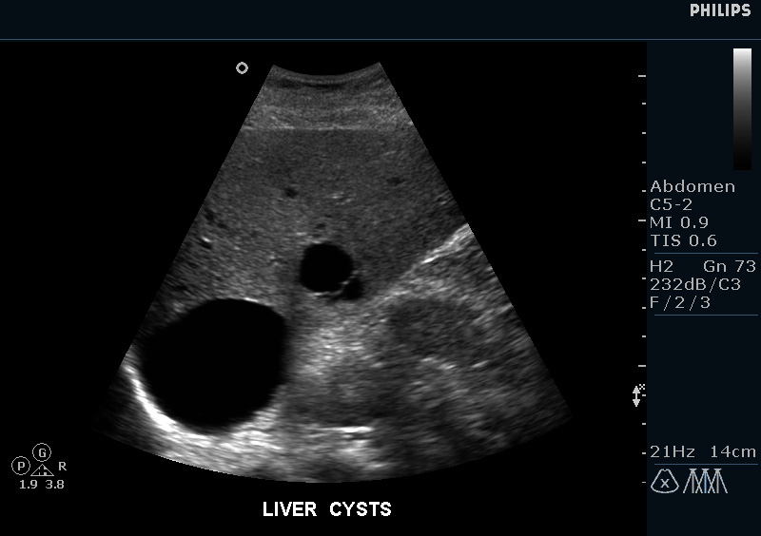
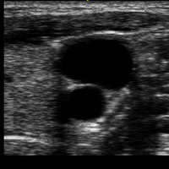
Reflected Echo’s
No Reflections = Black dots
Fluid within a cyst, urine, blood
‘Hypoechoic’ or echofree

Slide 18
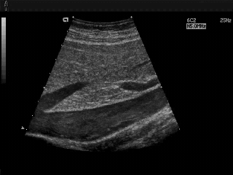

Slide 19
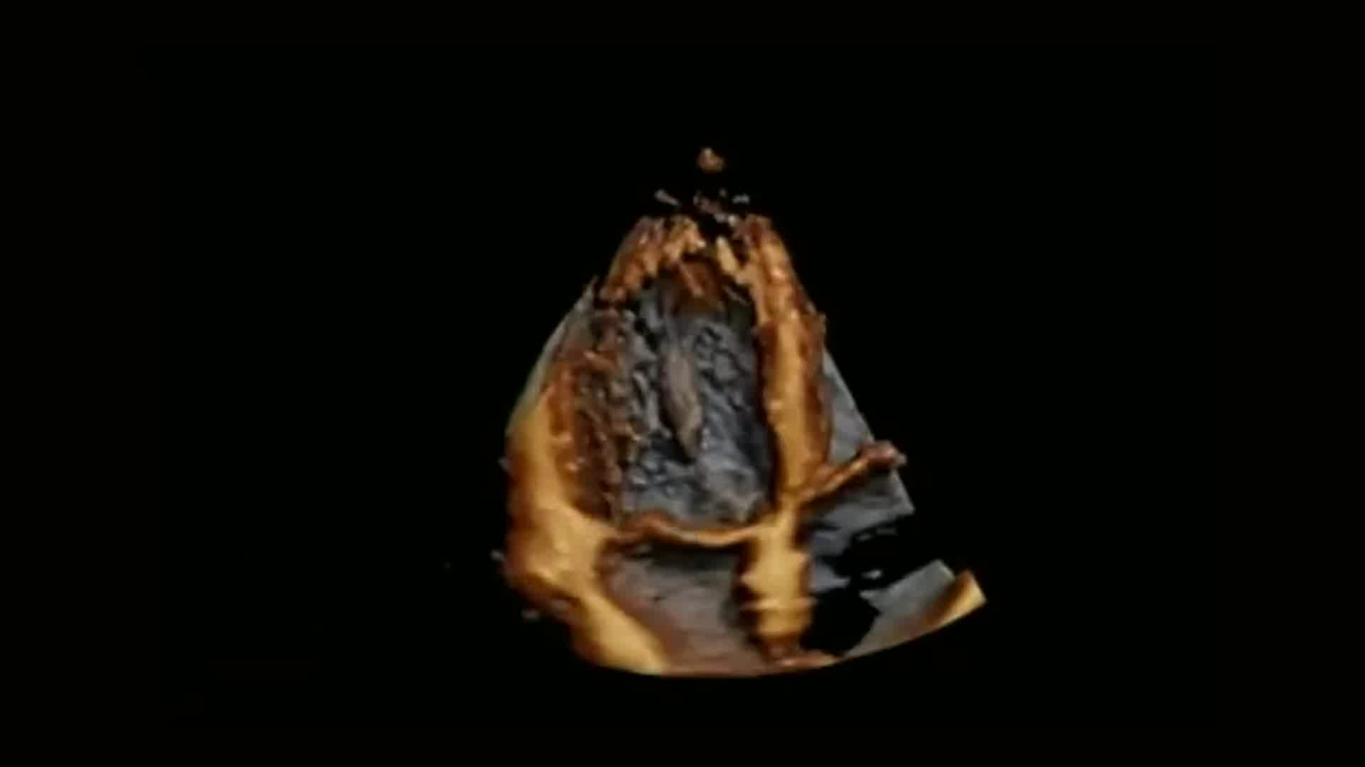
4D ultrasound

Slide 20
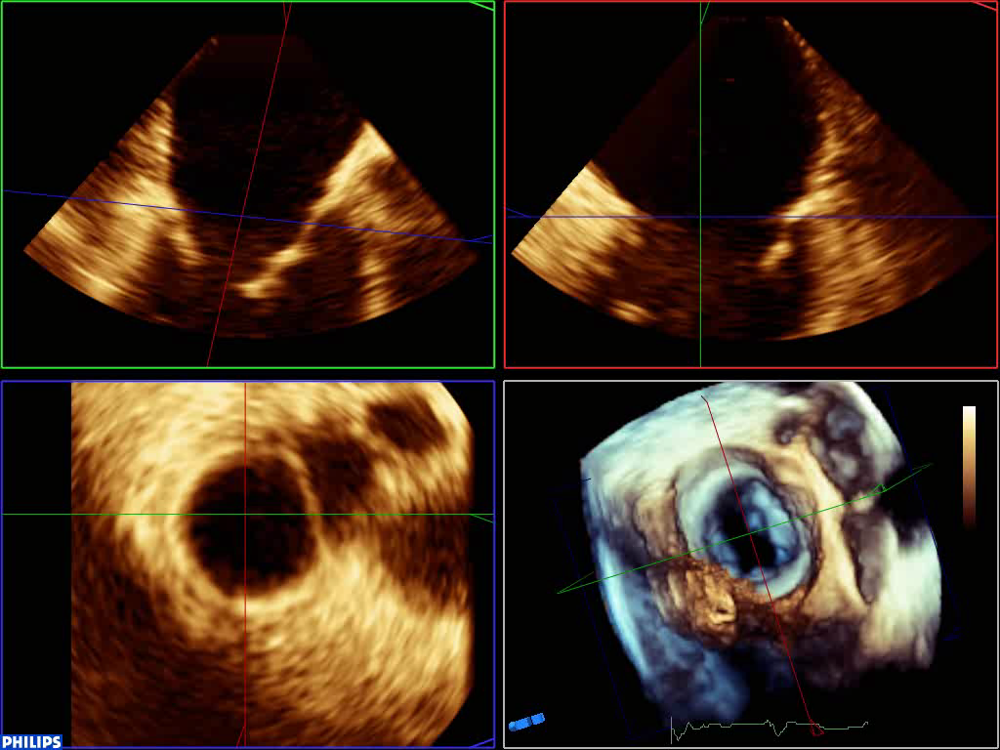
4D ultrasound

